Slide 1
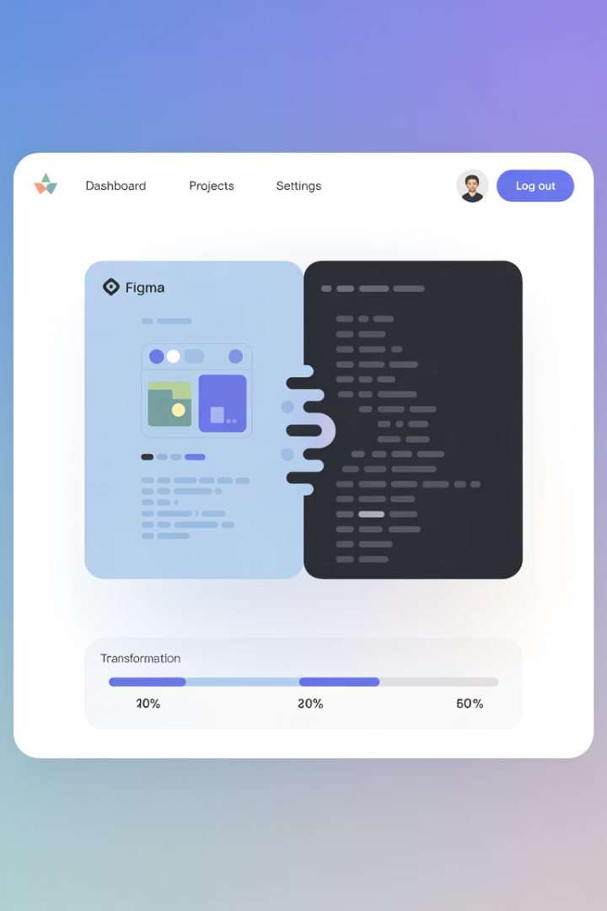
Figma to Code: AI-Powered Development Accelerator
A comprehensive solution for translating Figma designs into functional code through AI-powered processes, ensuring quality, compliance, and efficiency in development workflows.
AS
by Advik Sarang

Slide 2
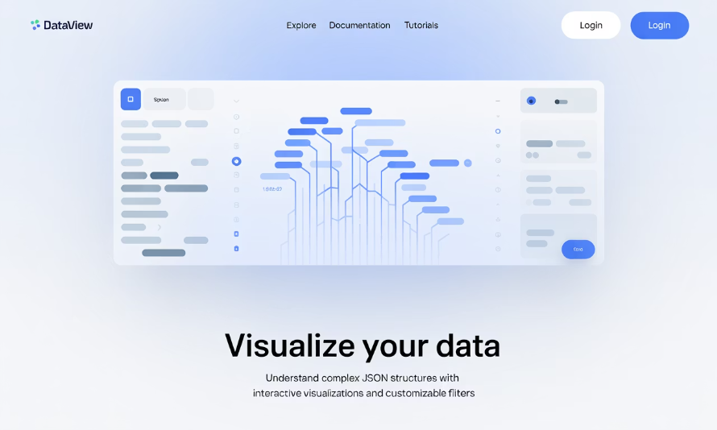
The AI Data Package: Linking Figma to Code Context
What we extract
This structured JSON package translates your Figma design into data the AI understands.
Why it's needed
Provides the essential context (styles, layout, structure) for accurate AI code generation.
{ "metadata": { // General info about the extraction "source": "FigmaDev Accelerator v1.0" }, "structure": { // How elements are nested (like Figma layers) "html_tree": "..." // Basic HTML structure guess }, "styling": { // Visual appearance details "css": ".container { display: flex; ... } .button {...}", // CSS rules from Figma properties "designTokens": { // Maps directly to Figma Styles & Variables "colors": {"primary": "#426B1F"}, // From Color Styles "typography": {"heading1": {"fontFamily": "Newsreader"}}, // From Text Styles "spacing": {"medium": "16px"} // From Variables or naming conventions } }, "layout": { // How elements are arranged "autoLayout": [ // Details from Figma's Auto Layout panel {"nodeId": "12:34", "direction": "row", "gap": 16, "padding": [8, 16]} ], "constraints": [] // Figma constraint settings (if applicable) }, "components": [ // Information about Figma Components {"name": "ProductCard", "nodeId": "56:78", "variants": ["default", "hover"]} // Component name & variants ], "userPrompt": "Generate a responsive React component..." // Optional developer instructions }

Slide 3
Why Not Just Use AI Directly? The Need for Foundation
Challenge
Problem with AI Alone
AI like Cursor is powerful, but lacks direct access to your specific, approved Figma design details (the exact styles, tokens, layout specs).
Generic Output: Without design context, AI generates code based on general knowledge, not your specific design system or visual requirements.
Inaccuracy: It might guess styles or layouts, leading to visual inconsistencies and non-compliance.
Requires Heavy Prompting: You'd need extremely detailed text prompts describing every visual aspect, negating the efficiency gains.
Our Solution's Advantage
Successful "Vibe Coding" Needs
The Figma Plugin provides the critical foundation – the structured, accurate design data.
Rich Design Context: The extracted data package (styles, tokens, layout).
Functional Requirements: User stories defining what the UI should do.
Result: AI (Cursor) can accurately translate the design and implement functionality, building good products efficiently.

Slide 4
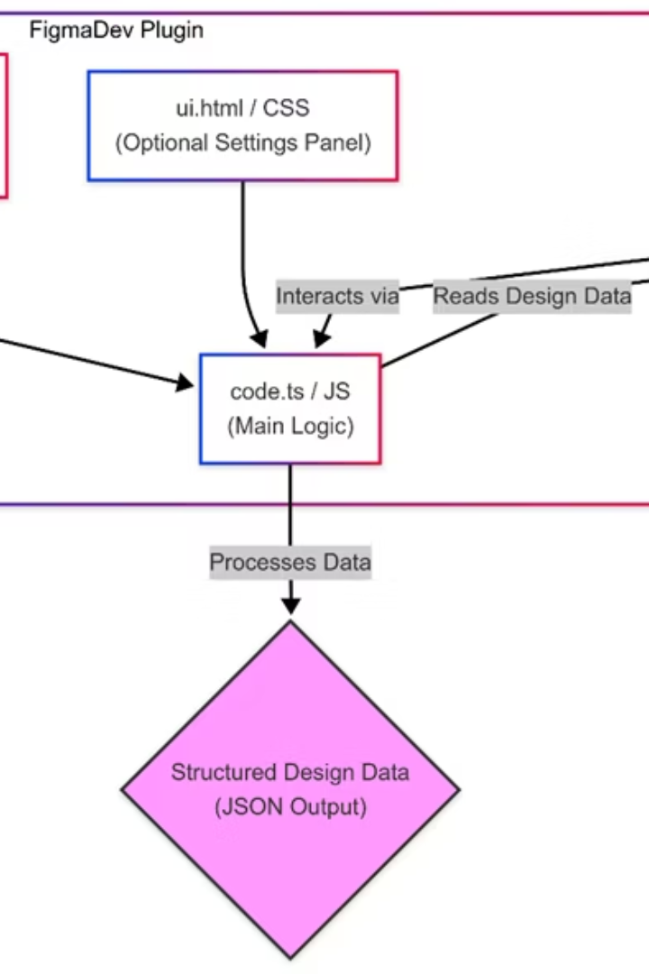



Plugin Architecture & Tech Stack
How the Plugin Works
Core Components
Runs inside Figma, interacting directly with the design file.
Configuration, UI (optional), and the main code logic using Figma's API.
Technical Stack
Figma Plugin API: Core interface for accessing design data.
TypeScript: Preferred language for type safety with the API (JavaScript also possible).
HTML / CSS: For building the optional plugin settings UI (ui.html).
Node.js / npm: For development environment, build process, managing dependencies.
Bundler (e.g., Webpack, esbuild): Often used to compile TypeScript/JavaScript and bundle code for Figma.

Slide 5
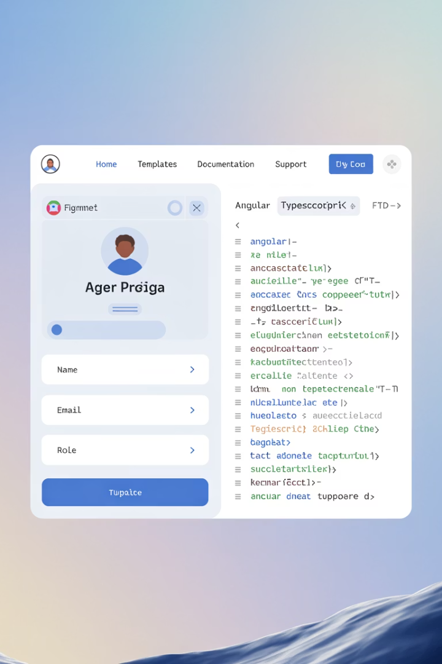




Part 2 - AI-Powered Vibe Coding (Angular Example)
Leveraging the Foundation
The detailed Design Data Package (from Part 1) provides the essential context for the AI.
Input Fusion
Combine the structured design data with specific User Stories or functional requirements.
AI IDE Integration
Utilize AI-native IDEs (e.g., Cursor) to process the combined input.
"Vibe Coding"
The rich context allows the AI to understand the intent (the "vibe") and generate not just snippets, but complete, working UI components/pages.
Target Output: Generate functional Angular components (or other frameworks) incorporating correct HTML structure & CSS (based on design data), basic component logic inferred from user stories, and integration of design tokens.

Slide 6
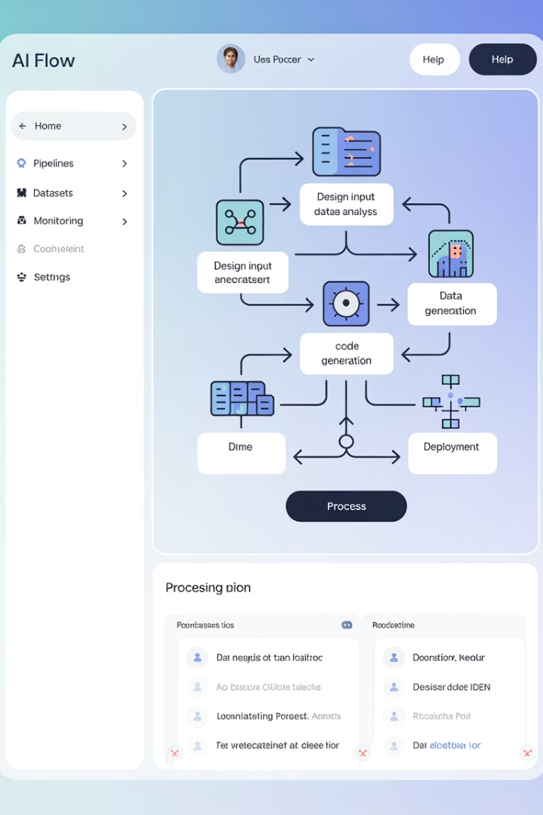
Step 3 - AI Processing & Code Generation (General)
Processing Interface
External Application (e.g., Streamlit) or IDE (e.g., Cursor): Provides the interface for processing.
AI Model Selection
AI Model Choice: Flexibility to use powerful models like Cursor AI, GPT-4, Gemini, etc.
Context is King: The structured JSON (and user stories in Part 2) provides rich context for the LLM.
Multi-Step Prompting
Sophisticated Prompting: Multi-step prompting guides the AI:
Analyze the design system tokens and structure.
Incorporate user story requirements.
Generate semantic HTML/Component structure (e.g., Angular).
Apply styling using extracted CSS and tokens.
Optimize for responsiveness based on Auto Layout data.
Enhance for basic accessibility (ARIA roles based on structure).

Slide 7








Ensuring Quality & Compliance: CI/CD Integration
Generated Code
Automated Checks
Generated Code is Just the Start: While accelerated, the output needs validation.
Integrate generated code into a customized Jenkins Pipeline (or similar CI/CD tool) for automated quality and security gates.
Pipeline Stages
Static Code Analysis (SAST): Scan code for security vulnerabilities (e.g., Checkmarx).
Dependency Scanning (SCA): Check libraries for known vulnerabilities (e.g., Nexus IQ / SonarQube Dependencies).
Gated Deployment
Code is only pushed to environments (Dev, QA, Prod) after passing all required pipeline checks.
Code Quality Analysis: Measure maintainability, complexity, standards adherence (e.g., SonarQube).
Container Security (if applicable): Scan container images for vulnerabilities (e.g., Twistlock / Prisma Cloud).
Result: Ensures the final product adheres to company standards, security guidelines, and quality benchmarks.

Slide 8
Future Directions & Enhancements
Direct LLM Integration in Plugin (Part 1)
1
Embed GenAI/LLM capabilities directly within the Figma plugin to generate framework-specific code (e.g., Angular HTML, React JSX) during the initial extraction, reducing reliance on basic HTML/CSS output.
Templated User Stories (Part 2)
Develop standardized templates for user stories focused on UI functionality. Feeding these alongside design data will provide richer context for AI "vibe coding," leading to more complete and accurate UI logic generation.
Enhanced Component Logic
Improve AI's ability to infer and generate basic component state, event handlers (e.g., @Output in Angular), and data binding based on design patterns and templated stories.
Design System Versioning & Validation
Align code generation with specific design system versions and potentially validate generated code against DS rules.
Interaction & Animation Mapping
Translate basic Figma prototype interactions (clicks, hovers) and simple animations into corresponding framework code snippets.
Advanced Accessibility Generation
Move beyond basic roles to generate more comprehensive ARIA attributes and potentially integrate automated accessibility checks.
Theme Switching Support
Generate code that easily supports light/dark mode or other themes defined using Figma Variables.
Bi-Directional Sync (Exploratory)
Investigate feasibility of reflecting structural code changes back into Figma (highly complex).

